Slide 1
Project-139
NATURAL LANGUAGE PROCESSING
Hotel Rating Classification
Mentor- Mr.Karthik and Miss Dhanyapriya
Starting date- 1/08/2022
Members
Aditi Mishra
Aishwarya Kodoth
Dimple Klair
Varun Thapa
Khamkar Dipak Vishwanath
Vaishnvi N
Nitesh Kumbhare

Slide 2
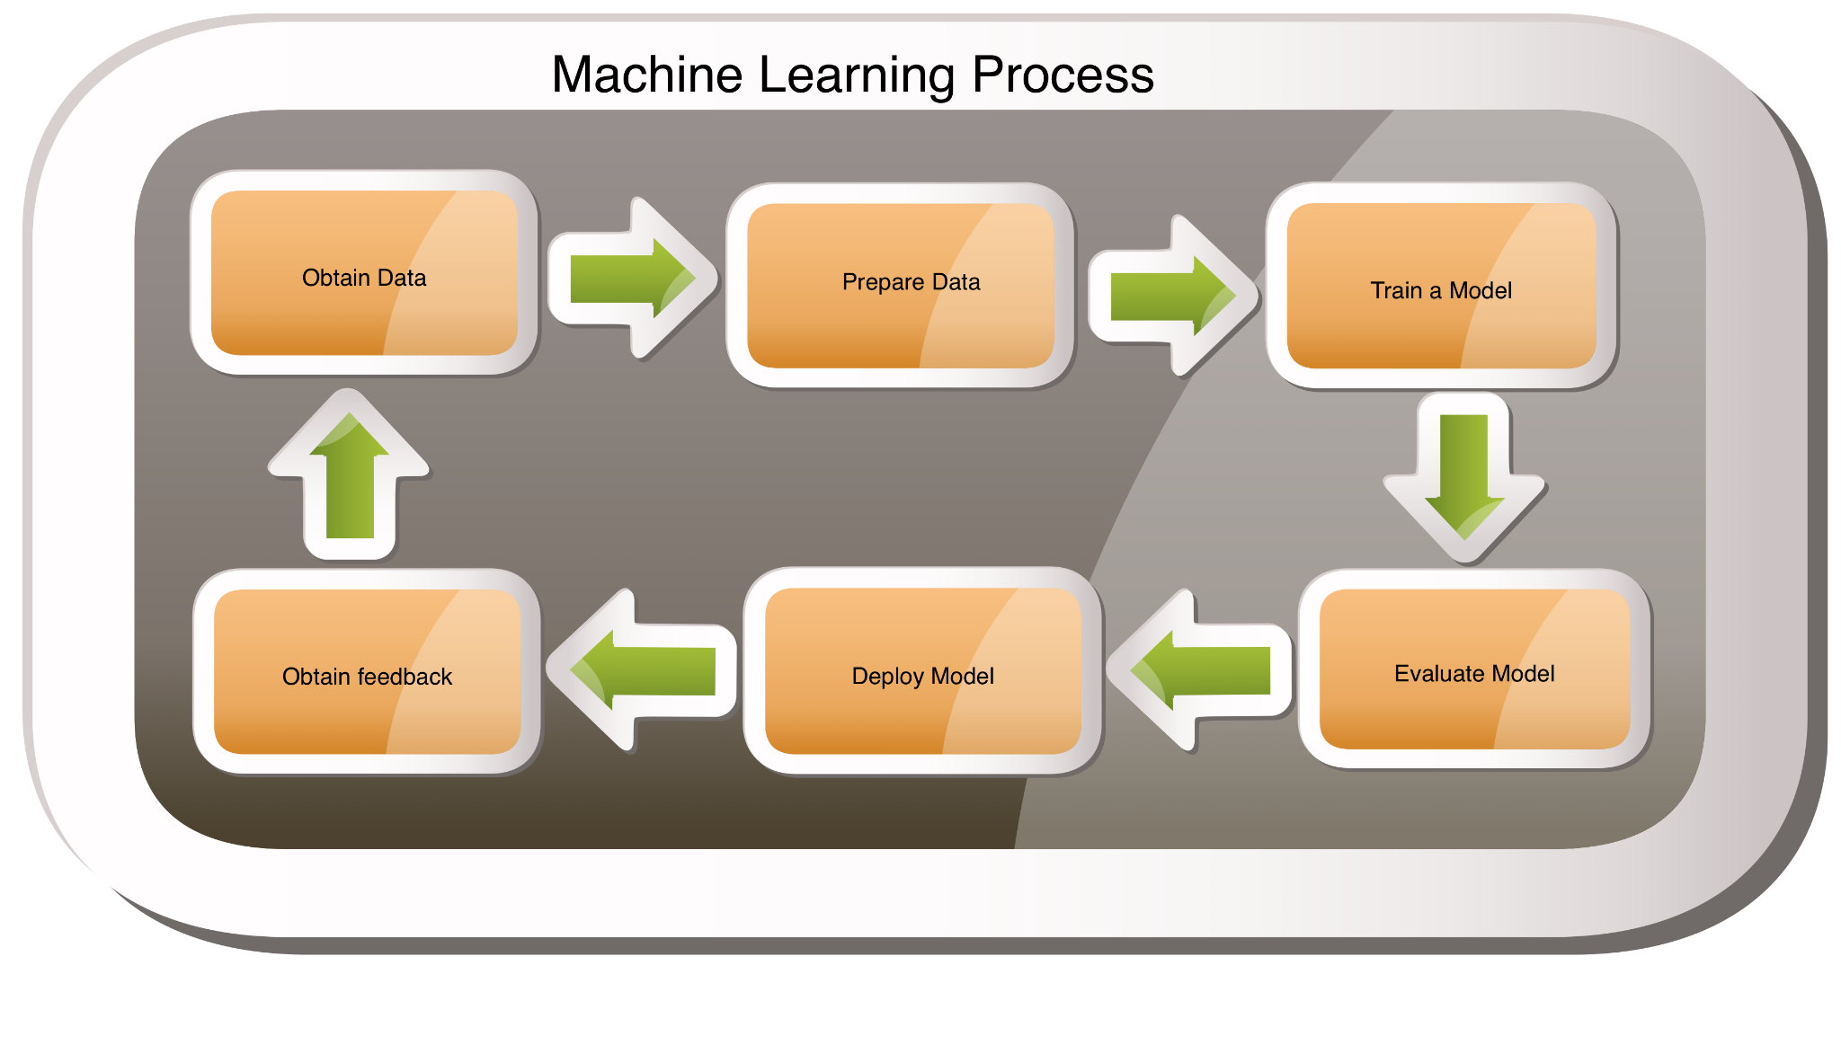

Slide 3

Business Objectives
-To know how services are being perceived and the Prospective consumers want to know what existing users think about the services thay experienced.
- Understanding of how online reviews have enormous power to effect hotel industries
-Also what are the amenities that travelers considered while selecting a hotel through Machine Learning.

Slide 4
EXPLORATORY DATA ANALYSIS
We had gone through some EDA to get better insights from the dataset through an intuitive analysis,to decide which analysis are expected to be performed, based on the dataset we have in our hand.
We have enough observations for training and testing.
Remove special characters using library re
Spell Check using library autocorrect
Expanding Contractions using library contractions
Removing Punctuations
Tokenization using library nltk
Converting Uppercase letters to Lowercase
Removing Stopwords using library nltk
Count Number of Words in single review
Number of characters in single review
Stemming
Lemmatization

Slide 5
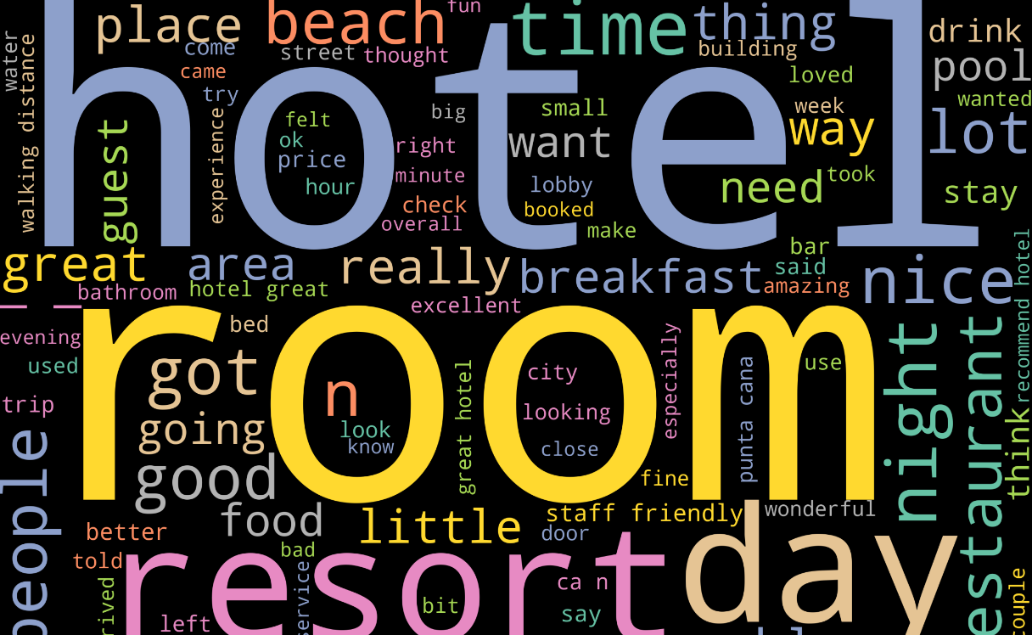
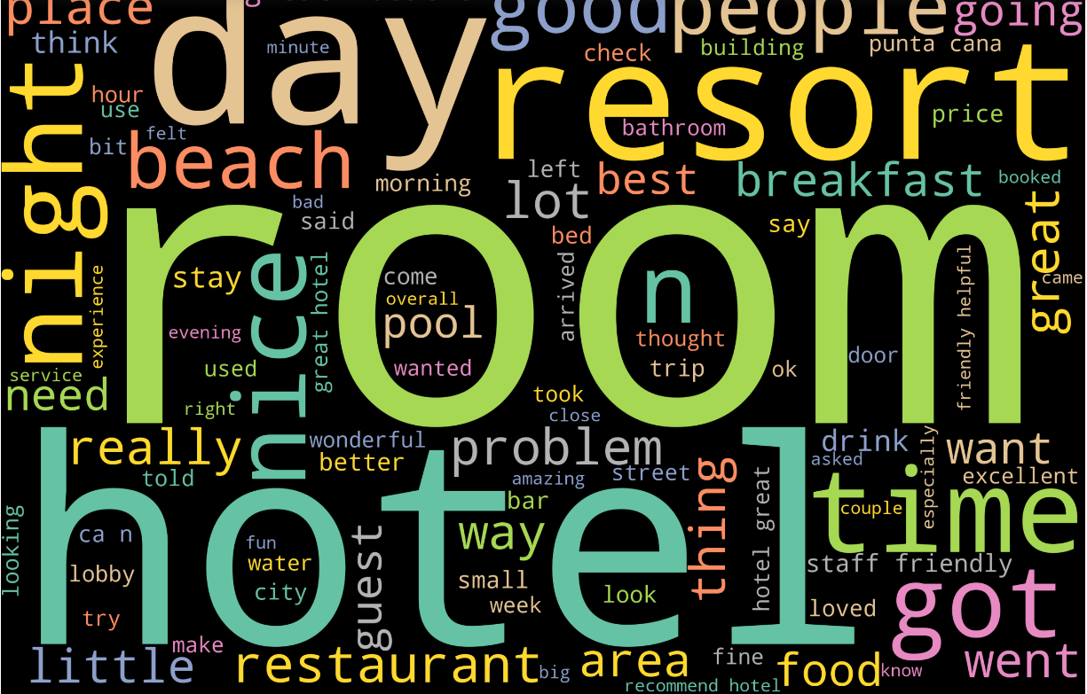
Wordcloud
Before EDA
After cleaning data
The best way to understand the words in our dataset is wordcloud. Here we pull out the most pertinent parts of our database.Each word differs in size based on the frequency.The size of each word dictates its relative importance.As we can see the word- hotel,room,resort,day are the most frequently used words, which actually plays a vital role for business growth.

Slide 6
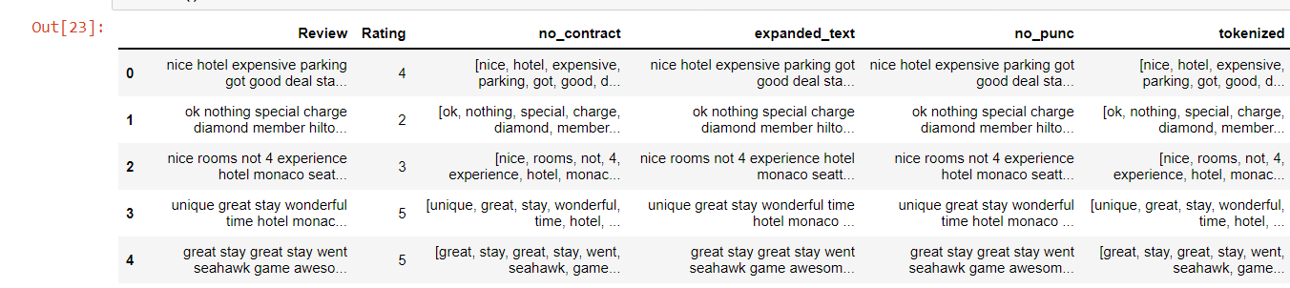

TOKENIZATION
Now it’s very easy to understand what is being said in reviews by the customers in dataset as everything is breaked into chunks.

Slide 7
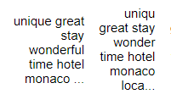

LEMMATIZATION
As we can see that the word changed into its root form like:-
unique- uniqu
wonderful- wonder
expensive-expens
parking-park

Slide 8
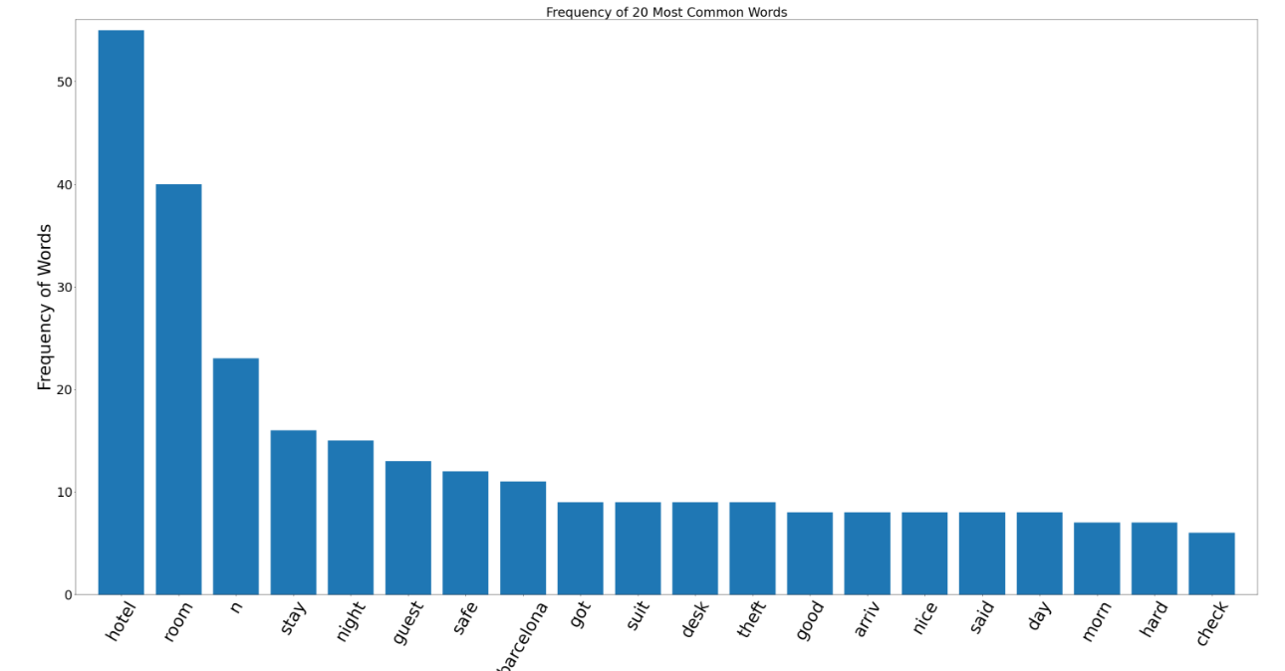
Top 20 most used words
According to the dataset we have some of the most commonly used words in reviews which directly indicated how they are important for a hotel business while providing amenities to their customers like - Hotel,room,stay,nice,day,safe etc…

Slide 9
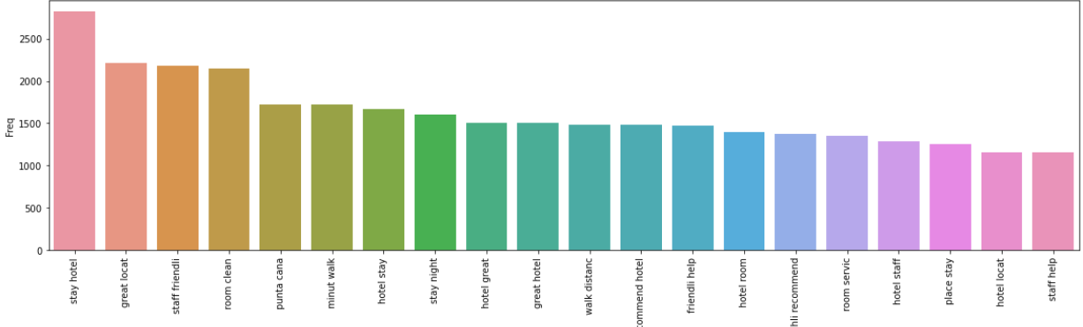
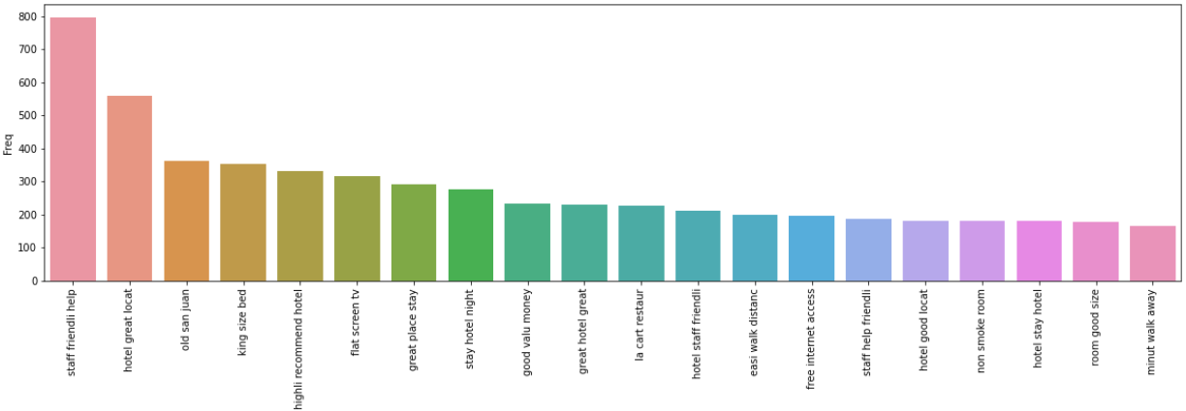
Bi gram
Here we have cut out the noise of all the rows from our data set. As now we got some meaningful information from the sentences.
BI GRAM-stay hotel,great location,room clean etc.
TRI GRAM-staff friendly help, hotel great location etc.
Too short n-grams may fail to capture important differences. On the other hand, if they are too long, it may fail to capture the “general knowledge” and only stick to particular cases.
Tri-gram

Slide 10
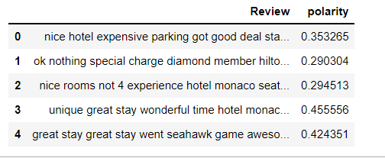
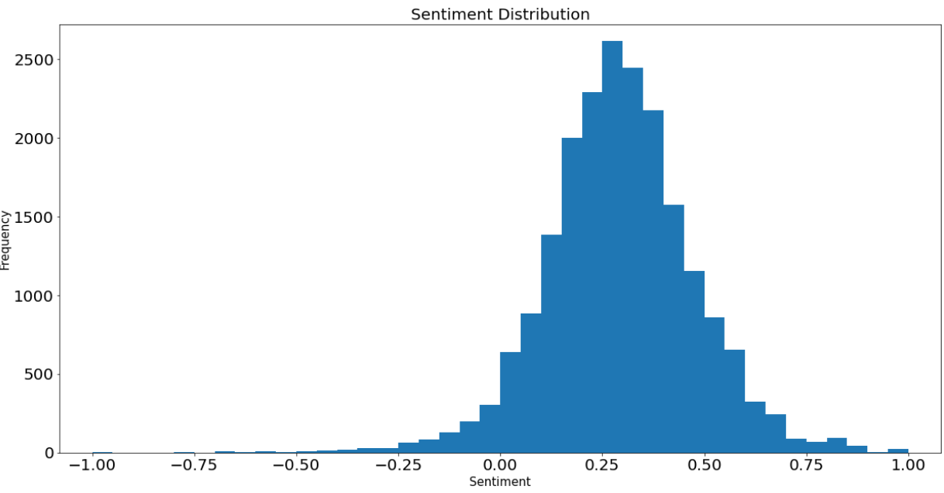
Sentiment Analysis
This can mainly help to understand the hatred/negative speech in text content in the dataset.
Here in our project we are detecting the polarity of the text and classifying then as positive, negative and neutral.
As we can see mostly the polarity is between 0.23 to 0.27, which indicates the positive reviews.
This project can be useful for such a way that it reduces the time for reading each and every reviews.

Slide 11
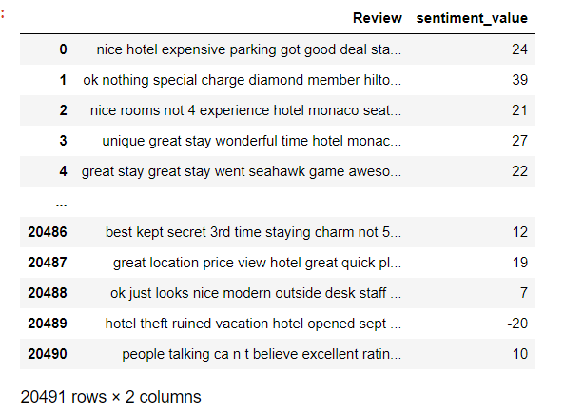
lexicons for sentiment analysis - using Afinn
From sentiment analysis we got that all these reviews have positive reviews.
As we can see -20 showing the negative feedback from the client.

Slide 12
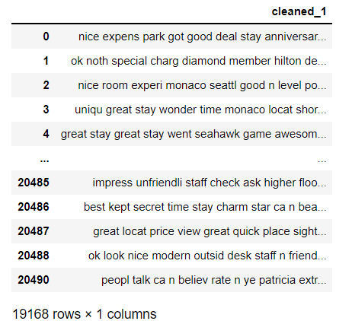
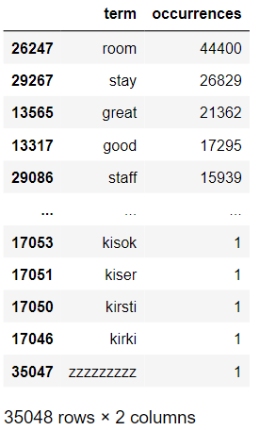
Feature Extraction for positive reviews
Model doesn’t accept textual data it only understands the numbers. So, here we vectorized the text data.
As we can see the term with their number of occurrences in positive reviews.
Here we have vectors like- room,stay,great etc……
we simply discards all the information and order of the text and just considers the occurrences of the word.
Count Vectorization on Positive reviews

Slide 13
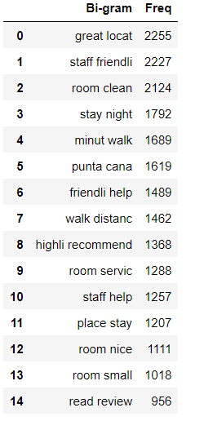
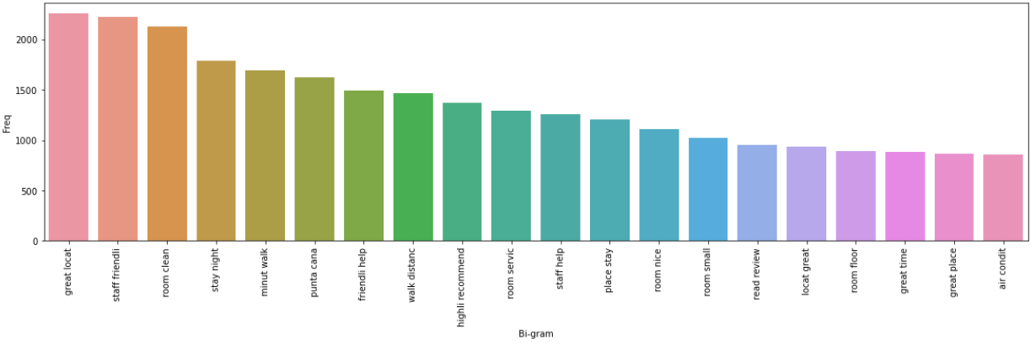
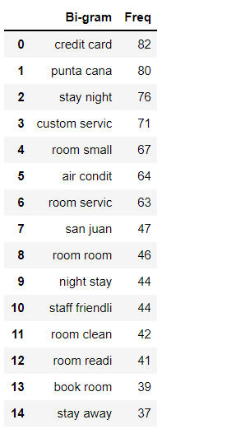
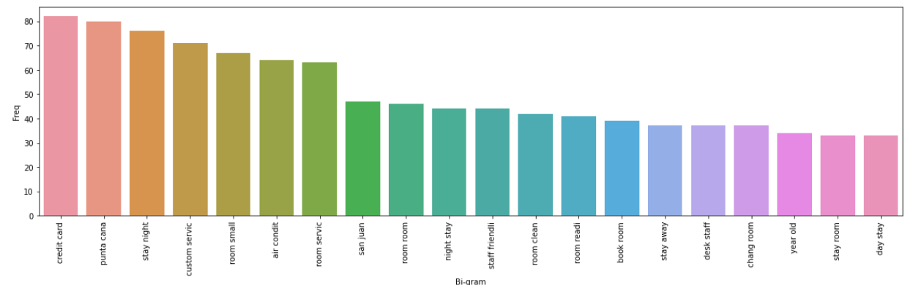
Bi gram of postive reviews with their frequency after Tfidf vectorization
Bi gram of negative reviews

Slide 14
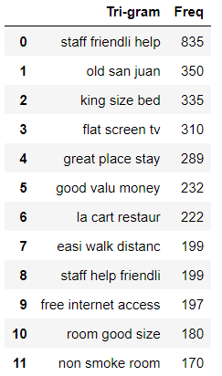
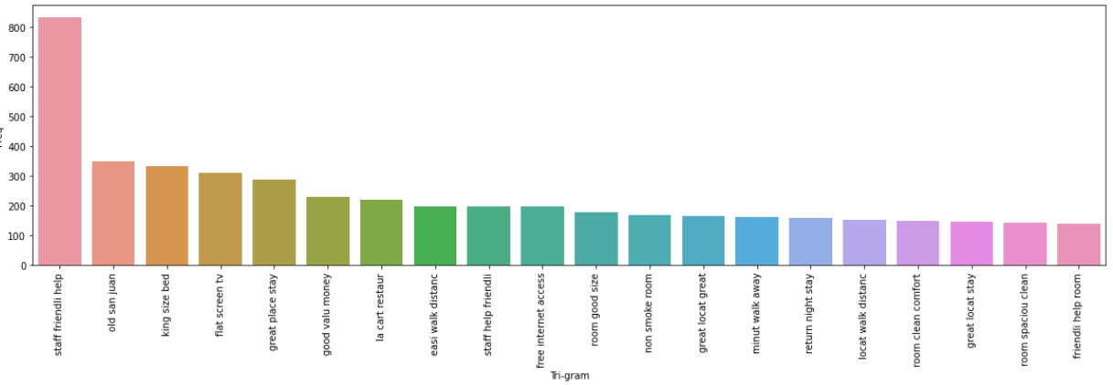
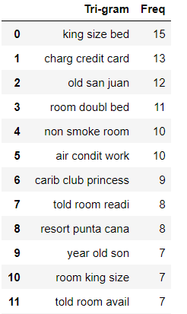
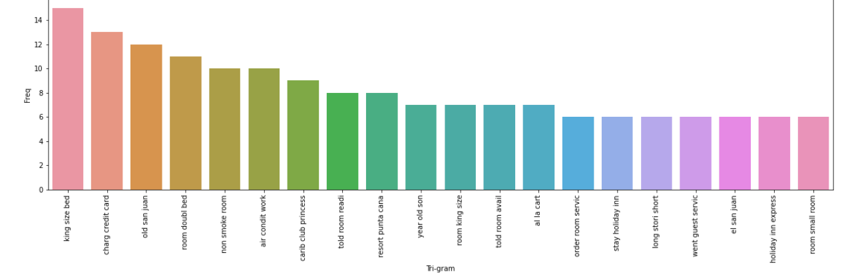
Tri gram of positive and negative reviews with their frequencies after tfidf vectorization

Slide 15
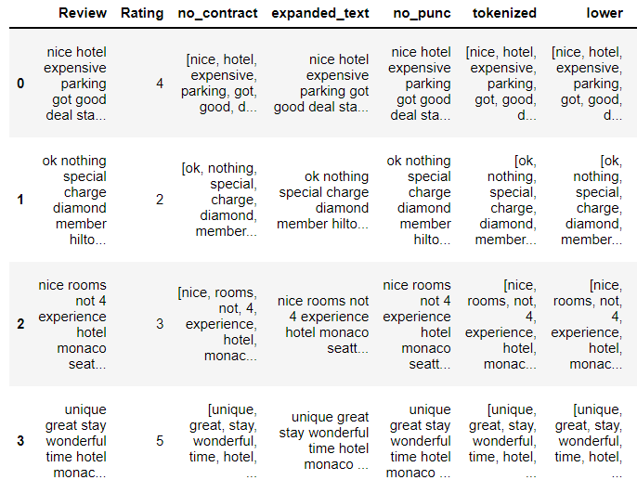
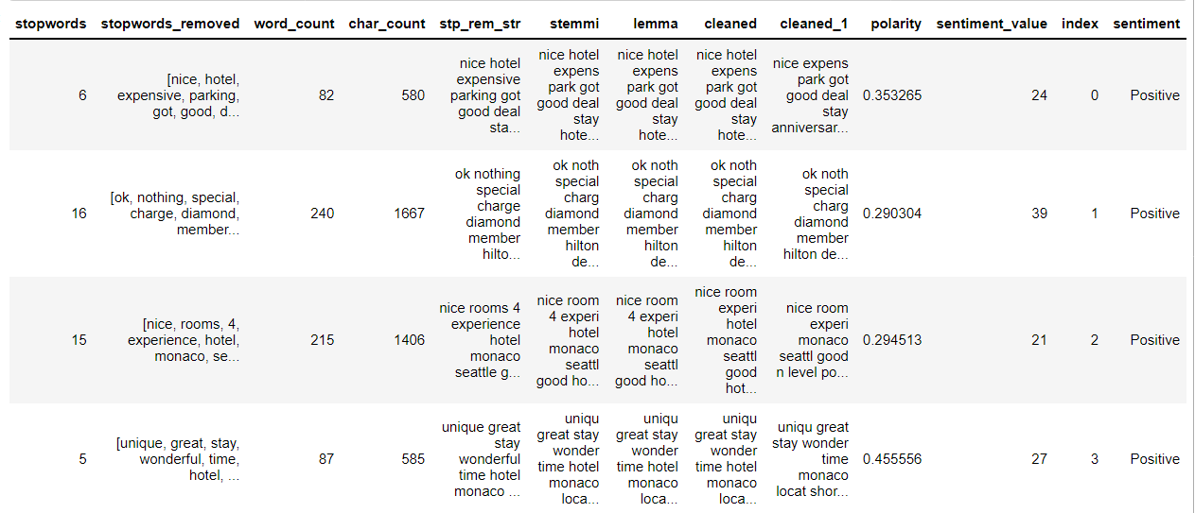
This is the final data we get in our hand after all the EDA process done by the team.
*Location of the hotel,
*friendly behaviour of staff members,
*room size, etc…
these are mainly responsible for the hotel reviews and rating.
Now we will apply some algorithms here to get accuracy score to build model.

Slide 16
MODEL BUILDING
After performing EDA and Feature Extraction on our dataset we have stared model building.We have divided the data into Train and Test with 33% as Test . We used SMOTE method for balancing the minority class in our dataset.
The models we have build are:-
'LinearSVC(BOW)',
'LinearSVC(TFIDF)',
'Random Forest(BOW)',
'Random Forest(TFIDF)',
'Multinomial Naive Bayes(BOW)',
'Multinomial Naive Bayes(TFIDF)',
'LGBMClassifier(BOW)'
,'LGBMClassifier(TFIDF)'
‘Adaboost’

Slide 17
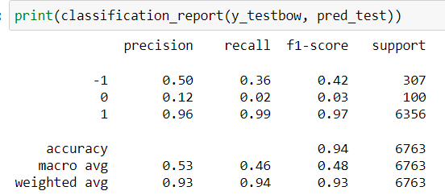
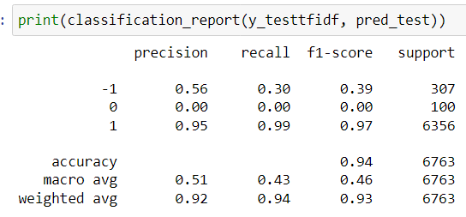
Random Forest classification
Logistic regression on BOW CountVectorizer balanced data
Accuracy of Training data = 98%
Accuracy of Test data = 94%
Random Forest classification on TFIDF on balanced data
Accuracy of Training data = 100%
Accuracy of Test data = 93%

Slide 18
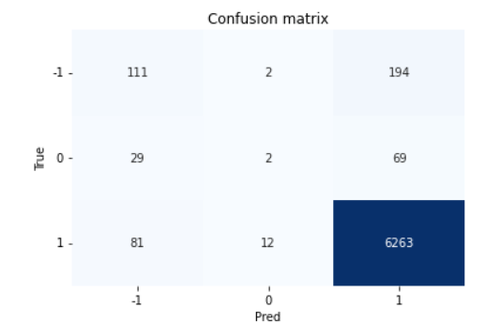
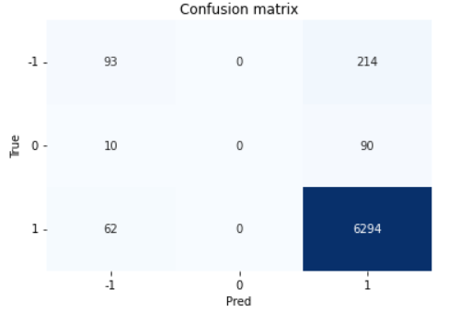
The Confusion matrix
Random Forest classification on BOW CountVectorizer balanced data
Random Forest classification on TFIDF on balanced data

Slide 19
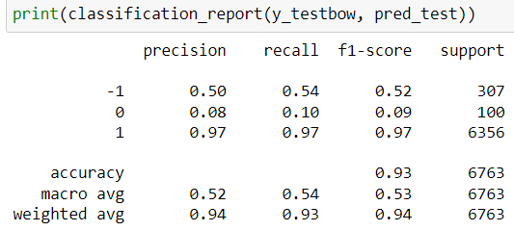
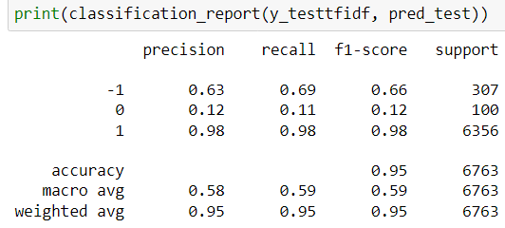
SVM(SUPPOT VECTOR)
SVM classification on BOW features on balanced data
SVM classification on TFIDF features on balanced data
SVM classification on TFIDF on balanced data
Accuracy of Training data = 99%
Accuracy of Test data = 95%
SVM classification on BOW CountVectorizer
balanced data
Accuracy of Training data = 95%
Accuracy of Test data = 93%

Slide 20
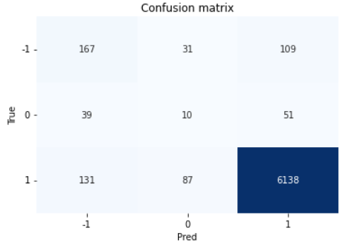
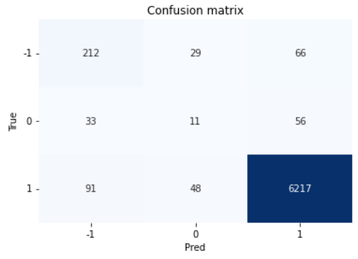
The Confusion matrix
SVM classification on BOW
CountVectorizer balanced data
SVM classification on
TFIDF on balanced data

Slide 21
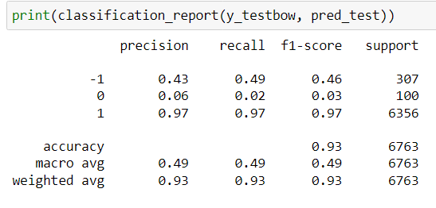
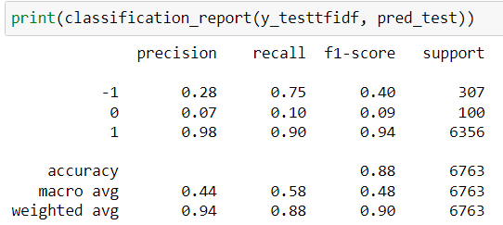
Naive Bayes classifier for multinomial models
Multinomial classification on BOW CountVectorizer balanced data
Accuracy of Training data = 84%
Accuracy of Test data = 93%
Multinomial classification on TFIDF on balanced data
Accuracy of Training data = 94%
Accuracy of Test data = 87%

Slide 22
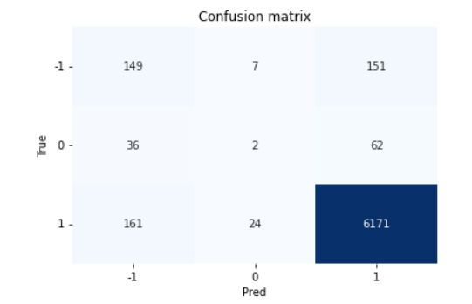

The Confusion matrix
Multinomial on BOW
CountVectorizer balanced data
Multinomial on TFIDF on balanced data

Slide 23
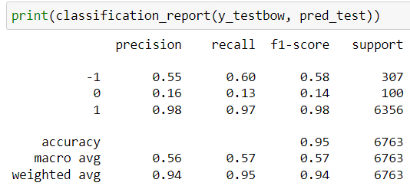
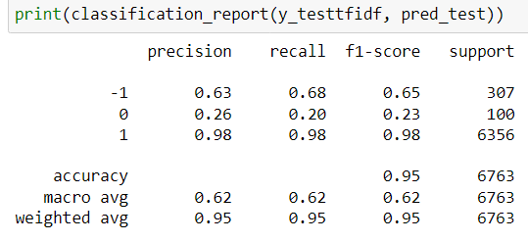
LGBMClassifier(Light Gradient Boosting Machine)
LGBMClassifier on BOW on balanced data
LGBMClassifier on TFIDF on balanced data

Slide 24
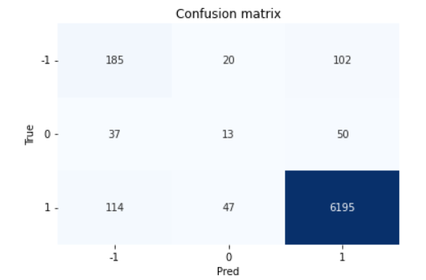
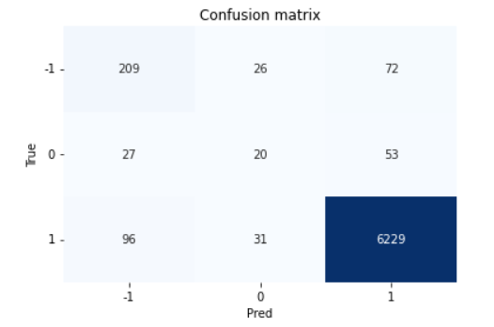
The Confusion matrix
LGBMClassifier on BOW on balanced data
LGBMClassifier on TFIDF on balanced data

Slide 25
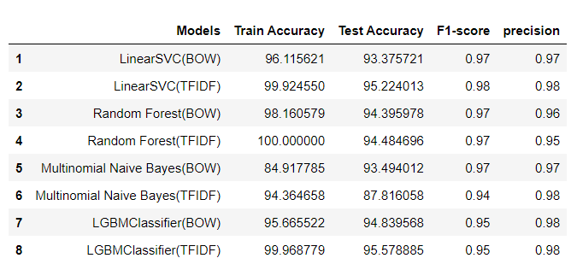
Summary of all the models's
As we can see using LinearSVC onTFIDF we got more accuracy

Slide 26
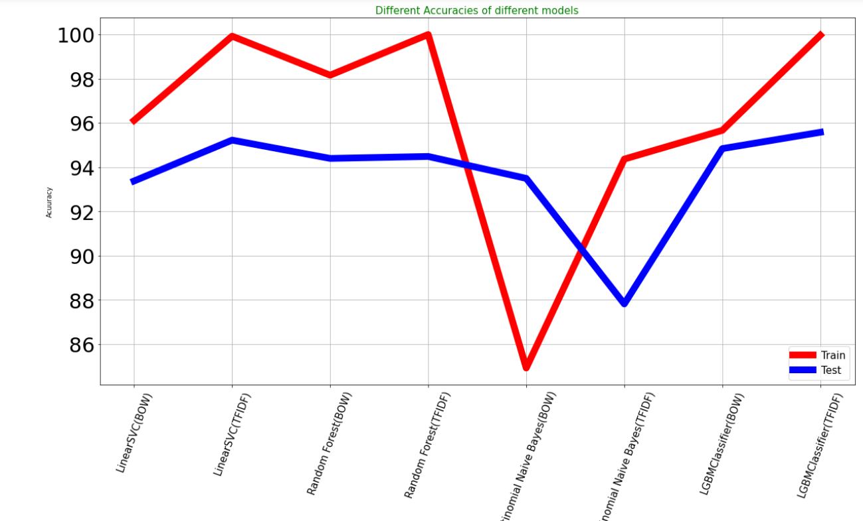
Model’s Accuracy
LinearSVC is giving us higher accuracy

